Slide 1
Corporate Environmental Impact: Measurement, Data and Information
Impact-Weighted Accounts Project Research Report
David Freiberg
DG Park
George Serafeim
T. Robert Zochowski
(Harvard Business School)

Slide 2
Background and Purpose
As an organization’s environmental impact has become a central societal consideration, thereby affecting industry and organizational competitiveness, interest in measuring and analyzing environmental impact has increased.
We develop a methodology to derive monetized environmental impact estimates in a comparable way across companies by applying characterization pathways and monetization factors to organization level environmental outputs, including carbon emissions, water use, and other emission types.

Slide 3
Background and Purpose
Against this backdrop, an increasing number of companies and investors are measuring and managing their environmental impact, and numerous organizations have emerged to provide guidance to various producers and consumers of information, including the Sustainability Accounting Standards Board (SASB), the Global Reporting Initiative (GRI), The Task Force for Climate-related Financial Disclosures (TCFD), and the Corporate Reporting Dialogue.
From an investor perspective, the challenge lies in measuring environmental impacts across many companies in a transparent, comparable, and reliable way so that the results can be benchmarked and assessed across the market and within industrial classifications.

Slide 4
Background and Purpose
In this paper, we develop a methodology using several established academic resources that allow us to measure an organization’s environmental impact from operations. To achieve this, we use characterization pathways and monetization factors from the Environmental Priority Strategies (EPS) Database, Available WAter REmaining (AWARE) Model, and Waterfund, along with organization level data of environmental outputs,6 such as carbon emissions, nitrous oxide, sulfur oxide, VOC, PM 2.5, and water withdrawal and discharge, sourced from Bloomberg and Thomson Reuters. Importantly, given disagreement in the scientific literature, we assess the sensitivity of our measurements to alternative discount rates. We also go to great lengths to reconcile and clean environmental output raw data as we find significant data inconsistencies and errors.

Slide 5
Key insights
environmental outputs
(such as carbon emissions, nitrous oxide, sulfur oxide, VOC, PM 2.5, and water withdrawal and discharge)
Black Box
How?
Measuring! How much?

Slide 6
Methodology
Bloomberg and Thomson Reuters
-> 100million USD 이상 기업만 측정
-> ESG 중 GHG, water discharged, water withdrawal 등의 자료가 있는 기업
온실가스 Bloomberg and Thomson Reuters 두개 사의 데이터 상관관계가 약 90% 이상
그러나 water discharge는 60% 정도이고, water withdrawal 는 13% 정도 매우 낮은 편
즉, 두 데이터의 오류가 큼

Slide 7
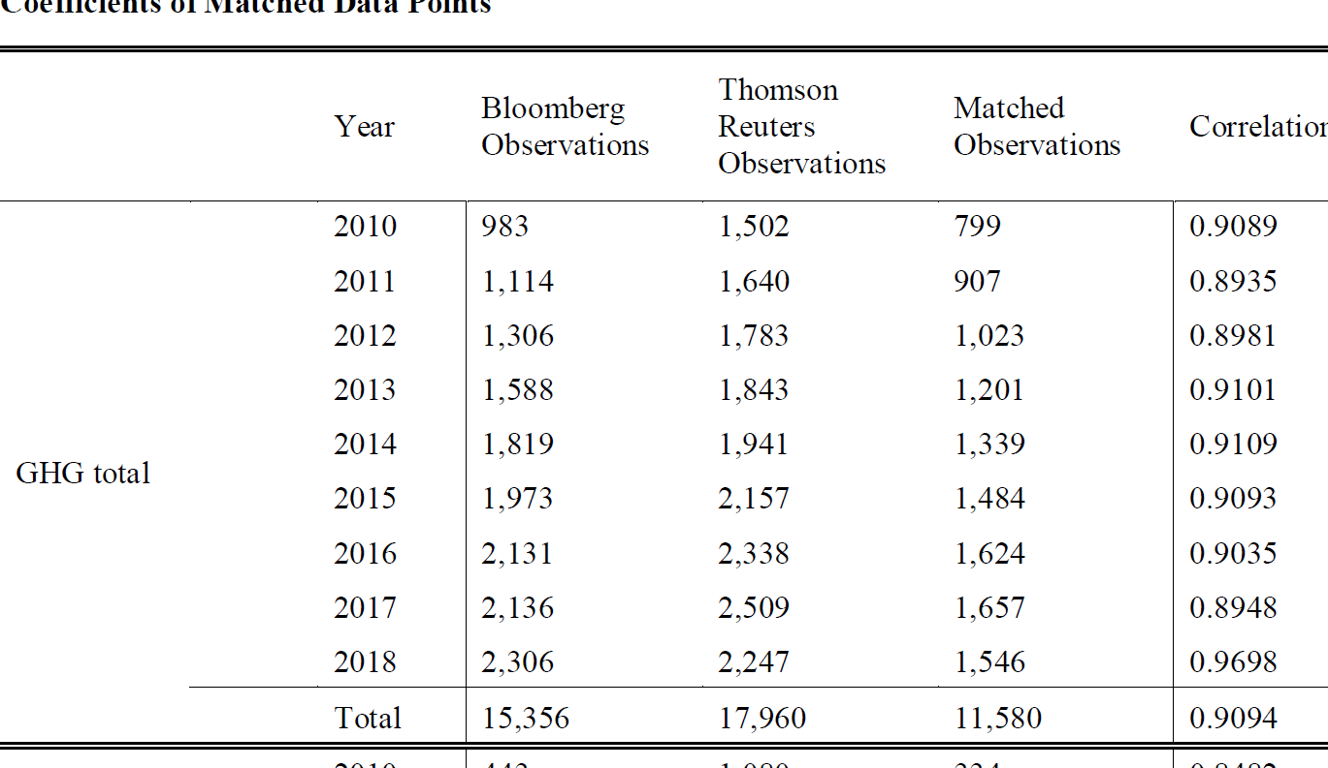
Methodology

Slide 8
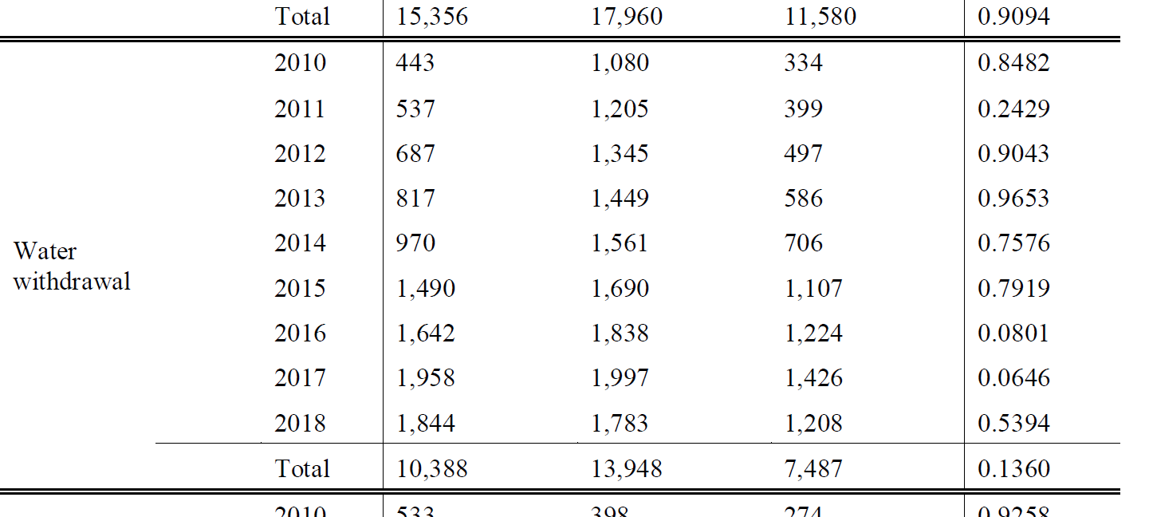
Methodology

Slide 9
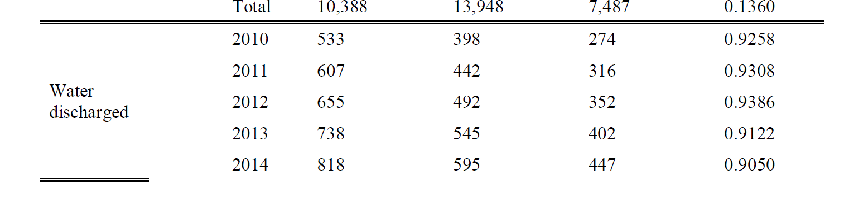
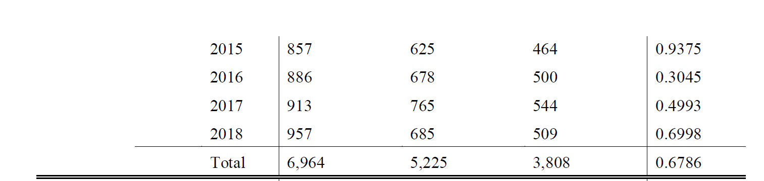
Methodology

Slide 10
Methodology
Bloomberg and Thomson Reuters
-> 100million USD 이상 기업만 측정
-> ESG 중 GHG, water discharged, water withdrawal 등의 자료가 있는 기업
온실가스 Bloomberg and Thomson Reuters 두개 사의 데이터 상관관계가 약 90% 이상
그러나 water discharge는 60% 정도이고, water withdrawal 는 13% 정도 매우 낮은 편
즉, 두 데이터의 오류가 큼
따라서, 차이가 10% 이상되는 기업은 제거. 단 하위 20% 일경우 극소량을 배출하기 때문에 두 데이터의 차이가 10%보다 크더라도 유지함
추가적으로 시계열적 자료확보를 위해 합병 등의 큰 변화가 없는 기업 중 50% 이상 변화가 생긴 기업은 제외함. 이는 데이터의 오류 혹은 기술변화 및 일부운영상의 큰 변화가 있다고 가정함.

Slide 11
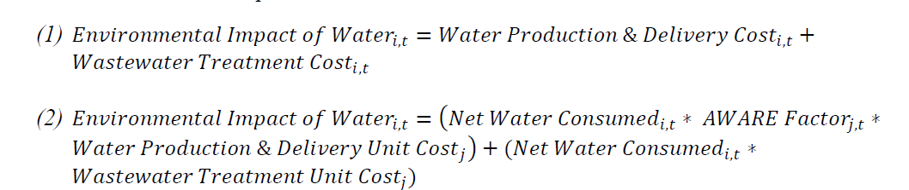
Methodology
Warter
The environmental impact of water is calculated using Waterfund’s global average water price and AWARE factors, as opposed to EPS factors used for monetization of emissions variables. Equation 1 defines the environmental impact of water.
Waterfund’s global에서 제공하는 물가격을 가장 신뢰하기 때문에 이 가격을 사용함. 먼저 EIW는 물공급비용과 물생산 비용에서 폐수처리비용의 합산으로 구함. 여기서 2번에서 소비된 물에서 생산된 물을 제외한 net 물의 소비량을 구한 다음 AWARE(전세계 물에 비한 지역별 물부족분을 곱함) 여기에 개별(지역별)생산공급비용을 가중하여 곱함.

Slide 12
Methodology
The AWARE model
The Availability WAter REmaining (AWARE) model provides supplemental water monetization factors, allowing us to account for the effect of local water scarcity.
지리적, 국가적 요소와 물류흐름간의 요소를 고려하여, 국가-지역별 물에 대한 수익성을 조사하는 방법 .
AWARE 국가별 자료를 통합하여 각 국가에 남아있는 사용 가능한 담수의 절대량평방미터별로 제공하는 방법. 즉, AWARE는 생태계에 필요한 물을 사용후 남는 여분의 물을 세계 평균에 비해 주어진 지역의 평방미터당 가용 물을 의미한다.

Slide 13
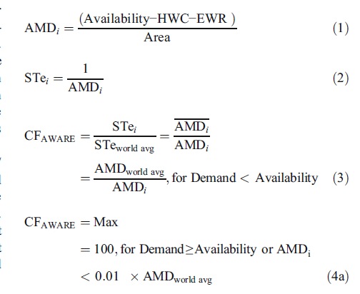

Methodology
TheWULCA consensus characterization model for water scarcity footprints: assessing impacts of water consumption based on available water remaining (AWARE), 2018, International Journal Life Cycle Assess, Boulay et al.

Slide 14
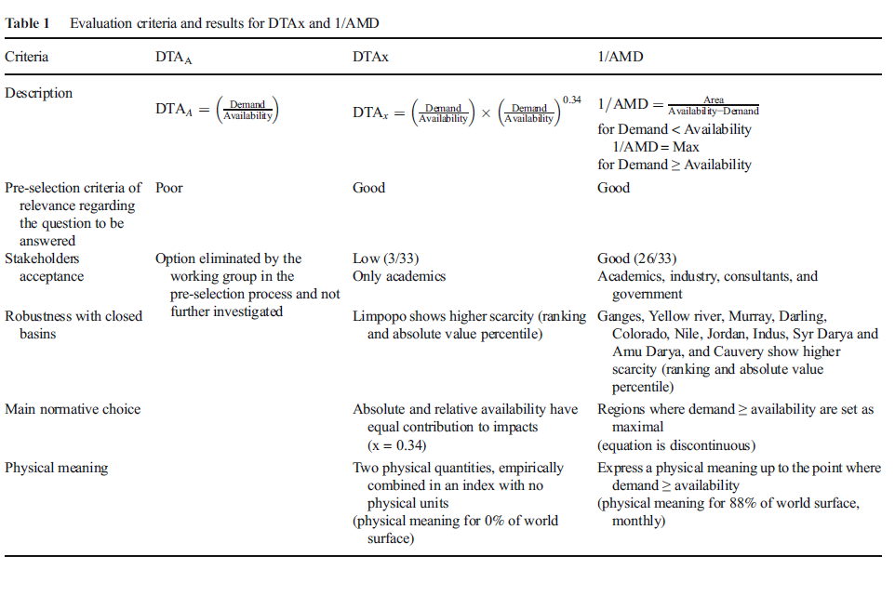
Methodology

Slide 15
Methodology
Waterfund’s Global Water Price
A global water price is sourced from Waterfund, which has developed a comprehensive measure of water cost for 19 locations globally. The Waterfund dataset provides two broad sub-categories, water production and delivery and wastewater treatment, each of which has components of operating expenses, depreciation, and non-operating expenses.
Financial data
Financial data was collected from Worldscope and converted to USD using year end exchange rates. In addition to using raw sales data as provided by Worldscope, we calculate return on assets (ROA), return on equity (ROE), Tobin’s Q, price to book value of equity, and leverage. All stock market data, such as total investment return, volatility, and market beta are also sources from Worldscope.

Slide 16
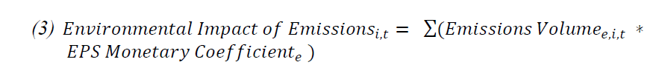
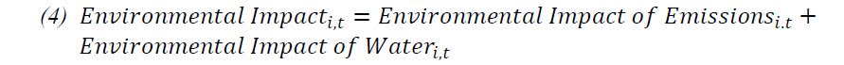
Methodology
Water and GHG
Environmental Priority Strategies (EPS) : Provide conversions from impacts denominated in the standard terms of impact, such as quality adjusted life years, into monetary values (usually $/kg emission or input).
Environmental Priority Strategies (EPS) measuring: Characterization Pathways are scientifically-based methodologies to transform outputs into impacts.

Slide 17
Methodology
First, we document that the average environmental intensity scaled by sales for our sample, assuming a zero discount rate, is 11.6%, but the median is only 1.9.
Next, we seek to explain what drives variation in environmental intensity across organizations.
We then examine the relation between environmental intensity and established environmental ratings from data providers.
we ask the question of whether market prices reflect environmental intensity.

Slide 18
Methodology
We ask the question of whether market prices reflect environmental intensity. We estimate the relation between equity valuation multiples, stock returns, volatility, and environmental impact and generate several insights: First, there is a moderate yet significant relationship between environmental intensity and valuation multiples. Second, the relation persists after accounting for environmental ratings, which we find not to be related to valuation multiples. Third, we identify the industries, such as electronic equipment, textiles and apparel, construction materials, and chemicals, in which the relation between valuation multiples and environmental impact is the strongest. We infer that environmental impact is a financially material signal across most industries.

Slide 19
Results
Overall, our first main conclusion is that measurement of environmental impact from operations is feasible for many companies in the economy with publicly disclosed data. Our paper provides a methodology into how one could go about constructing those impact measurements. Our second main conclusion is that these measurements contain information that is different than that of environmental ratings widely used by investors and other stakeholders, and that this information is value relevant.

Slide 20
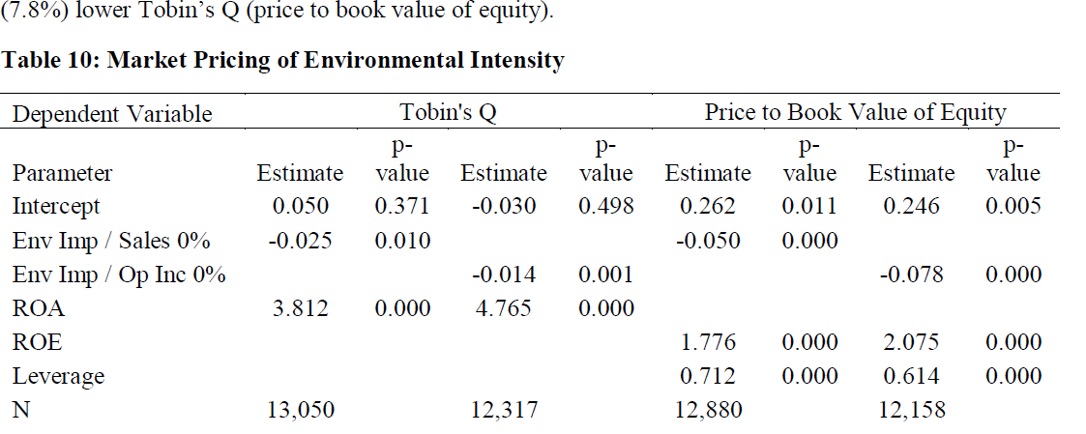
Results

Slide 21
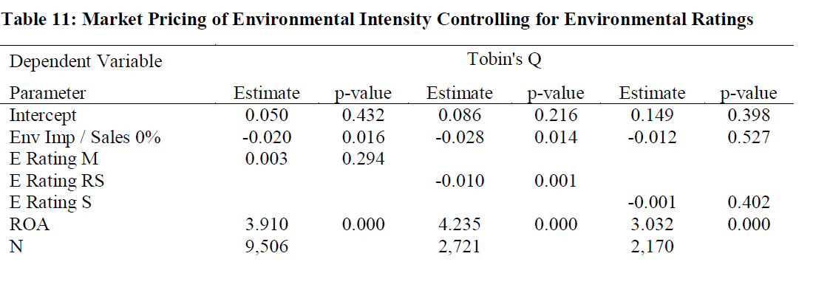
Results

Slide 22
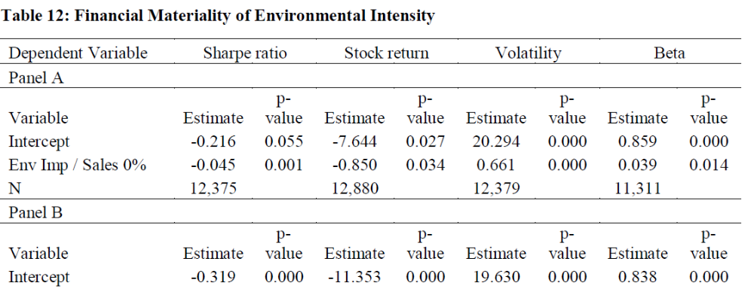
Results

Slide 23
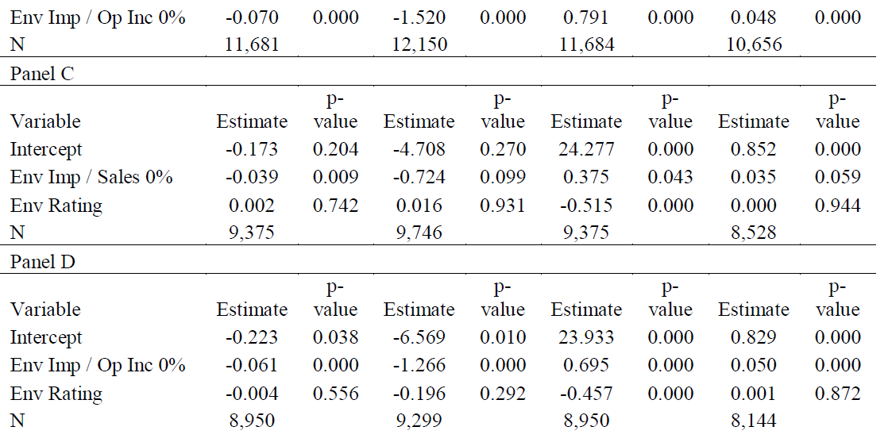
Results

