Slide 1
Corporate Sustainability: First Evidence on Materiality
Mozaffar Khan
(Harvard University and University of Minnesota)
George Serafeim
Aaron Yoon
(Harvard University)

Slide 2
INTRODUCTION
Purpose
Using newly available materiality classifications of sustainability topics, we develop a novel dataset by
hand-mapping sustainability investments classified as material for each industry into firm-specific sustainability
ratings.
Background
Firms release a wealth of information in the form of ESG data, but the sheer number of sustainability issues that attract investment raises the question of which of these ESG data are more or less material.
The materiality of the different sustainability issues likely varies systematically across firms and industries
As such, a new organization, the Sustainability Accounting Standards Board (SASB), adopts a shareholder viewpoint in defining materiality and develops standards for reporting of ESG issues concentrated on discriminating between material and immaterial issues.

Slide 3
Motivation and HY
Motivation
Using newly available materiality classifications of sustainability topics, we develop a novel dataset by hand-mapping sustainability investments classified as material for each industry into firm-specific sustainability ratings.
The prior academic literature on the performance implications of sustainability investments has adopted a number of different viewpoints.
One viewpoint is that such investments are efficient from shareholders’ perspective (Cochran and Wood 1984; Waddock and Graves 1997).
(2) A second viewpoint is that sustainability investments disproportionately raise a firm’s costs, creating a competitive
disadvantage in a competitive market
There is mixed evidence in the prior literature on the relation between sustainability and performance
Why? Couse? (One of them )
Materiality!!

Slide 4
DATA
Data
Using newly available materiality classifications of sustainability topics, we develop a novel dataset by hand-mapping sustainability investments classified as material for each industry into firm-specific sustainability ratings.
Materiality Data Our data collection is driven by the availability of materiality guidance from the SASB, which is an independent 501(c)3 non-profit whose mission is to develop and disseminate sustainability accounting standards that help publicly listed corporations disclose material factors in compliance with SEC requirements.
SASB standards are designed for the disclosure of material sustainability issues in mandatory SEC filings, such as the Form 10-K and 20-F.
* The investor focus of the SASB is narrower compared to other organizations such as the Global Reporting Initiative (GRI), which has a multi-stakeholder focus.
For each strength or concern rating applied to a company, KLD includes a ‘‘1’’ indicating the presence of that screen/criterion and a ‘‘0’’ indicating its absence. In total, seven issue areas are included: (1) Community, (2) Corporate Governance, (3) Diversity, (4) Employee Relations, (5) Product, (6) Environment, and (7) Human Rights.

Slide 5
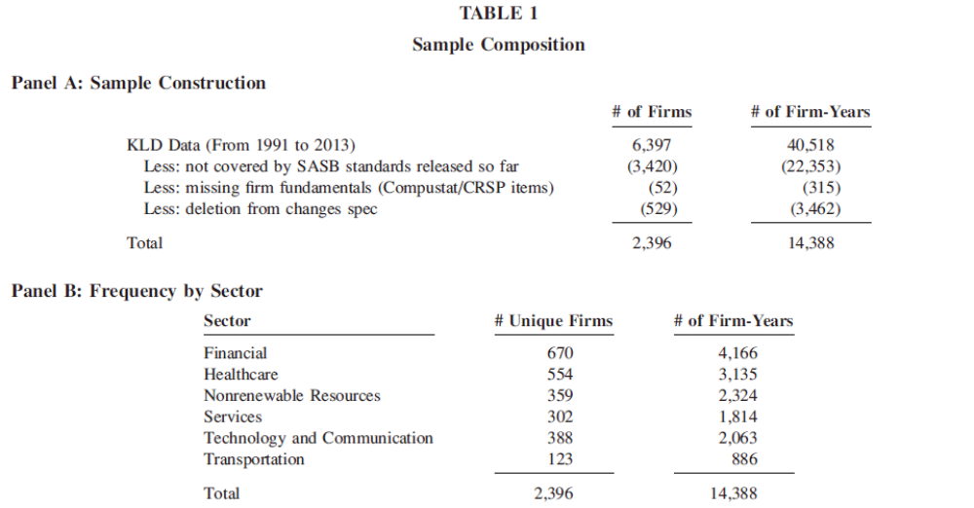
SAMPLE

Slide 6
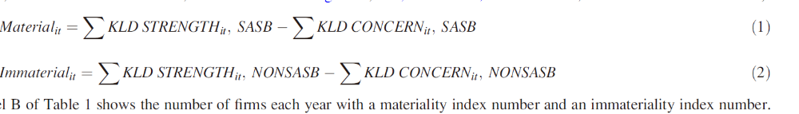
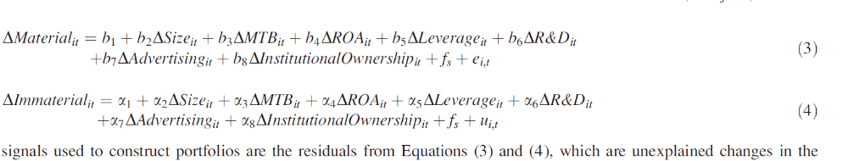
MODEL
The signals used to construct portfolios are the residuals from Equations (3) and (4), which are unexplained changes in the materiality and immateriality indices

Slide 7
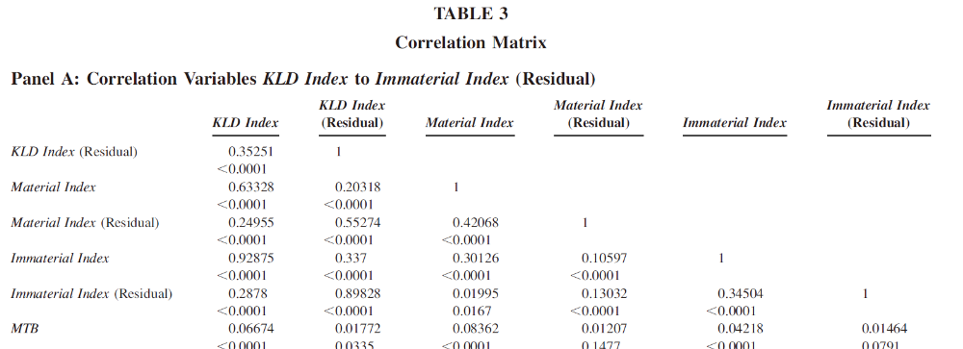
RESULTS

Slide 8
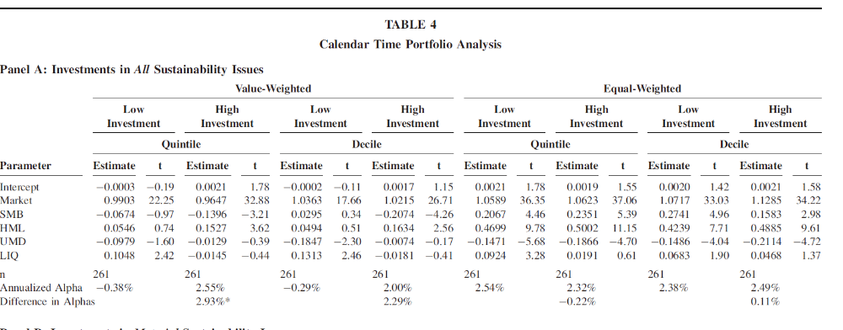
RESULTS

Slide 9
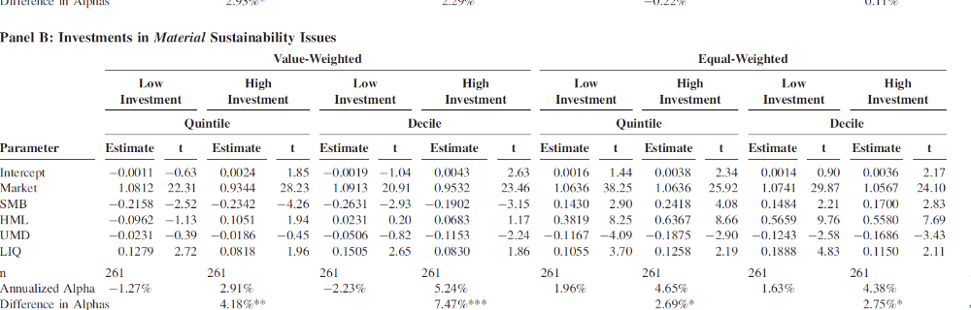
RESULTS

Slide 10
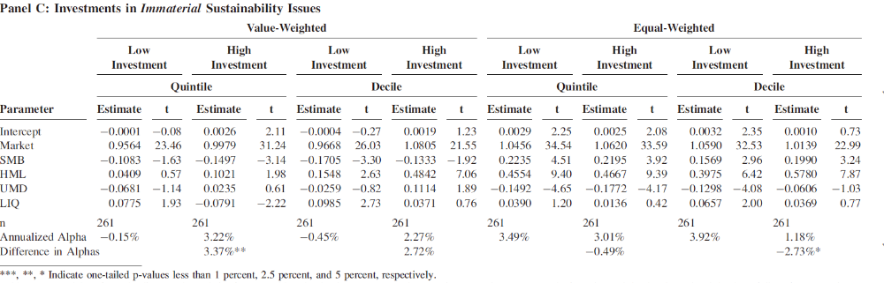
RESULTS

Slide 11
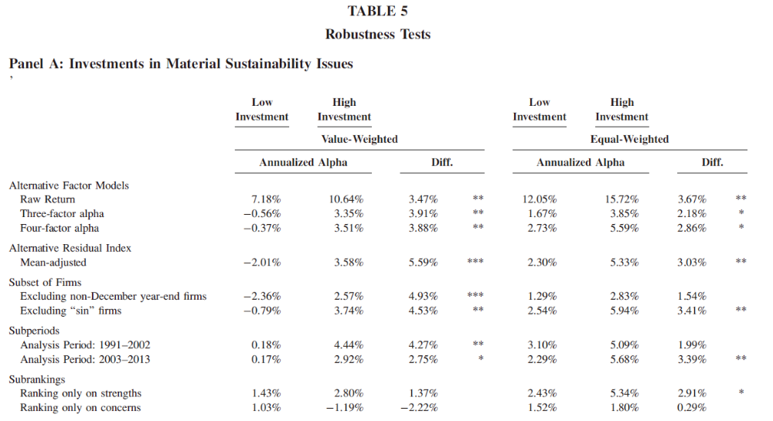
RESULTS

Slide 12
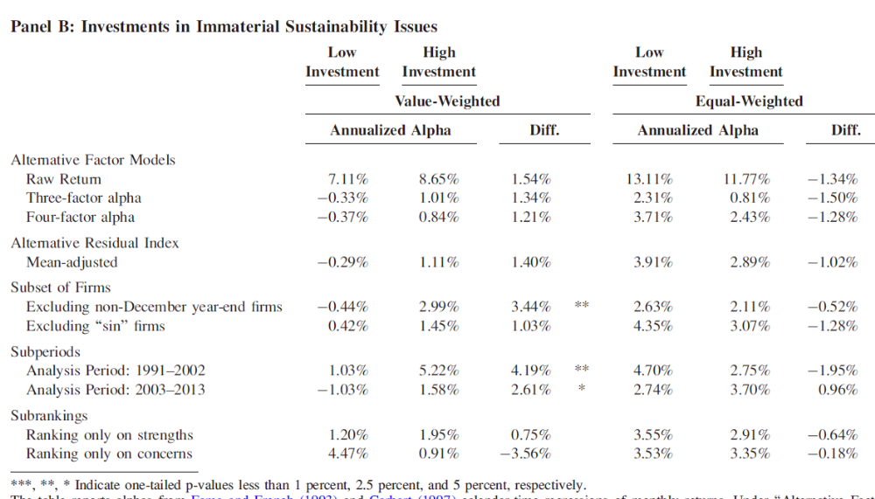
RESULTS

Slide 13
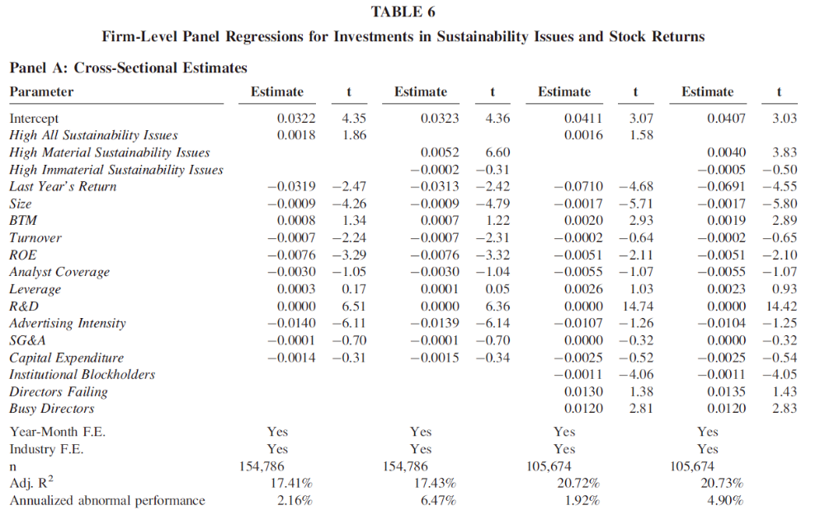
RESULTS

Slide 14
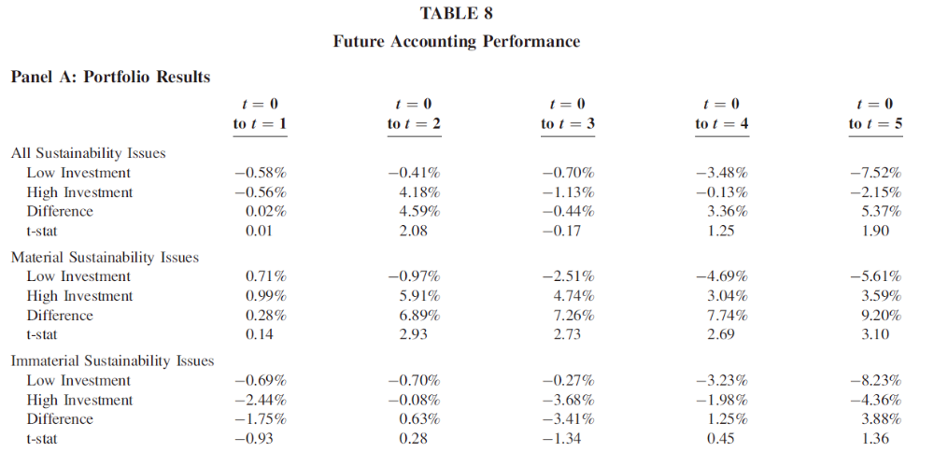
RESULTS

Slide 15
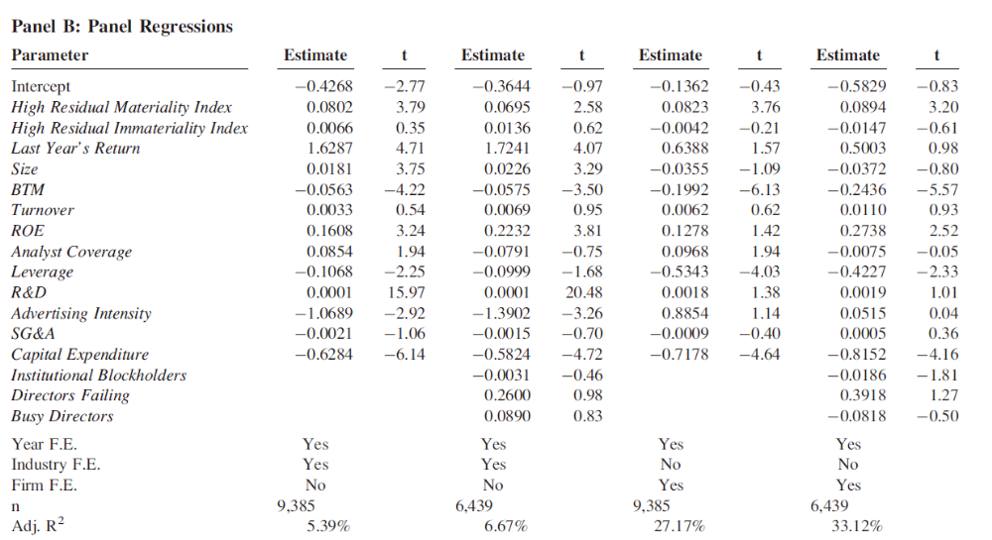
RESULTS

Slide 16
CONCLUSION
We find that firms with strong ratings on material sustainability issues have better future performance than firms with inferior ratings on the same issues. In contrast, firms with strong ratings on immaterial issues do not outperform firms with poor ratings on these issues.
Finally, firms with strong ratings on material issues and concurrently poor ratings on immaterial issues have the best future performance. Collectively, these results are consistent with materiality guidance being helpful in improving the informativeness of ESG data for investors.
Given the robust relation between investments on material sustainability issues and future financial performance, it would be important to examine the structural relations that lead to this association.

